Slide 1
Presented to:
Md. Imran Hossain
Assistant Professor
Department of ICT
Comilla University
Presented by:
Md. Omar Faruk
ID:11809034
Department of ICT
Comilla University

Slide 2
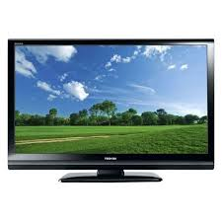
INTRODUCTION OF TELEVISION

Slide 3
What is Television?
Television is a widely used telecommunication system for broadcasting and receiving moving pictures and sound over a distance.
The word television derived from Latin word “tele” means far and “vision” means sight.

Slide 4
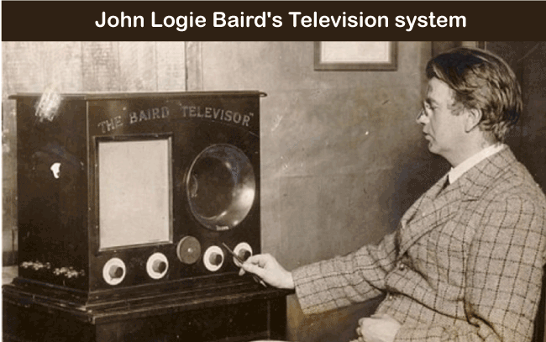
Who invented television?
It has always been a matter of contradiction that who invented the television because the credit can not go to a single person. It occurred across several stages. Since there were many inventors who claimed for their patent, but the names considered the pillars of this great invention is John Baird.

Slide 5
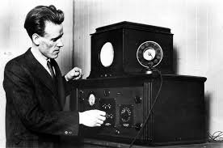
EVALUTION OF TELEVISION
Before 1800s, Paul Gottlieb Nipkow develop the first mechanical module of television.He succeeded in sending images through wires with the help of a rotating metal disk.This technology was called the “electro telescope” that had 18 lines resulation.

Slide 6
IN 1907
Campbell Swinton and Boris Rosing used the cathode ray tube (CRT) in addition to the mechanical scanner system,to create a new television system.
From the experiments of the Nipkow and Rosing two types of television system came into existence:
1.Mechanical television
2.Electrical television

Slide 7
Mechanical television
Mechanical television is a television system that provides on a mechanical scanning device,such as a rotating disk with holes in it or a rotating mirror drum,to scan the scene and generate the video signal,and similar mechanical device at the receiver to display the picture.This contrast with vaccum tube electronic technology using electron beam scanning method.Such as cathode ray tube (CRT) and LCD are used to create and display television pictures.

Slide 8
Electrical Television
Electrical television system based on the CRT.In this television an electrical beam could scan a picture horizontally lines,rotating it 90 degree and reproducing an image.Which resulation is good,have no noise and more compact size with a fewer visual limitations.

Slide 9
TYPES OF TELEVISION
Television are categorized in based on their structure.Here some types of television are given below:
1.Depending on television technology:-
Quantam Light Emiting Diode(QLED)TV
Organic Light Emiting Diode(OLED) TV
LED and LCD TV
2.Depending on screen:-
Flat screen TV
Curved screen TV
3. Depending on resulation:-
720p TV
1080p TV
4.Depending on features:-
Smart TV
High Dynamic Range(HDR) TV
Voice activated TV

Slide 10
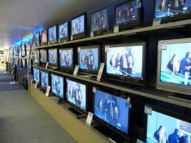
Different types of television

Slide 11
Thank you everyone…

